Slide 1
Chapter 11
What Works and What Doesn’t

Slide 2
The Selection Problem (you can’t see what didn’t happen)
This is ρ
<0 in our hospital example (why?)

Slide 3
Randomized Experiments
Randomization makes getting the treatment independent of what Y_{0i} is
It’s like randomly sending some people to hospital and others not, then comparing their health afterwards
This makes…

Slide 4
Mexico’s PROGRESA Program (Now OPORTUNIDADES)
In 1997, poor countries didn’t have major protection programs for the rural poor
Many had social security and medical insurance
  but only for formal-sector (mostly urban) workers
Radical new idea: Hand money to poor people
  Mostly women
  Conditional on kids in school and clinics

Slide 5
A Social Experiment
Impossible to launch full program at once
Rolled out to randomly chosen villages
Looked like a drug trial
  (without the placebo)
Baseline surveys of everyone determined eligibility
After a year, see what happens
A near-perfect randomized experiment!

Slide 6
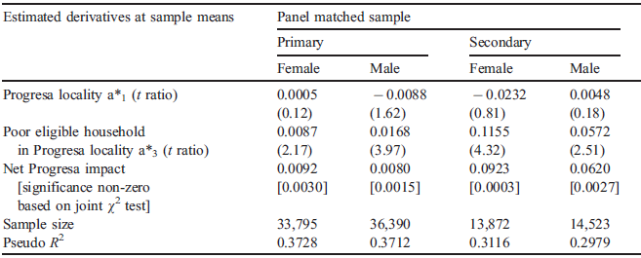
A Classic PROGRESA Study
Enrollment in school of kid i at time t (S_{it}=1 if enrolled, 0 otherwise; P_{i}=1 if a PROGRESA village; E_{i}=1 if household is eligible for PROGRESA):
Really Shouldn’t Matter
P_{i}: Kid i in randomly assigned PROGRESA village; E_{i}: eligibility dummy
T. Paul Schultz. 2004. School Subsidies for the Poor: Evaluating the Mexican PROGRESA Poverty Program. Journal of Development Economics 74(199-250).

Slide 7
“The World Bank is finally embracing science.”
“Creating a culture in which rigorous randomized evaluations are promoted, encouraged, and financed has the potential to revolutionize social policy during the 21st century, just as randomized trials revolutionized medicine during the 20th.”
-Esther Duflo

Slide 8
Social Cash Transfers in Africa
Malawi: reduction in child morbidity, gains in school enrolment, increases in food consumption, decrease in child labor
Ethiopia: increase in school attendance for some groups, particularly younger children; reduction in male child labor
South Africa: increased school attendance, decreased hunger, increased access to cell-phone use and AIDS among school-age girls

Slide 9
Other Examples of Randomized Control Trials (Chapter 11)
Hope
AIDS
Vaccines (The Last Mile)
Worms
Credit
Insurance

Slide 10
A Real-world RCT

Slide 11
A Real-world RCT
Goal: “Reduce extreme poverty and the intergenerational transfer of poverty” in programme households
Households with a child under the age of 5
Geographically targeted to the three districts with the highest rates of mortality, morbidity and stunting among children under age 5

Slide 12
Transfer
Flat ZMK 60,000 per month to each household
  On average represents 27 percent of monthly expenditure (Handa et al, 2013).

Slide 13
Study
Baseline (September–October 2010)
First follow-up in the same period in 2012
  final follow-up planned for July-August, 2013
2515 households, 1228 treatment, 1287 control)

Slide 14
Randomization Strategy
Randomization by Community Welfare Assistance Committees (CWACs)
  Clusters of villages
CWACS randomly assigned to treatment (December 2010) or control (to be brought into the programme at the end of 2013).
Baseline data collection before villages randomly assigned to treatment or control
  Comparisons show randomisation was effective

Slide 15
Data (1 Year Later)
(From Excel Spreadsheet)

Slide 16
Some Findings
Big Question: Why? Need structural model.
Reduced form methods can’t answer that question.

Slide 17
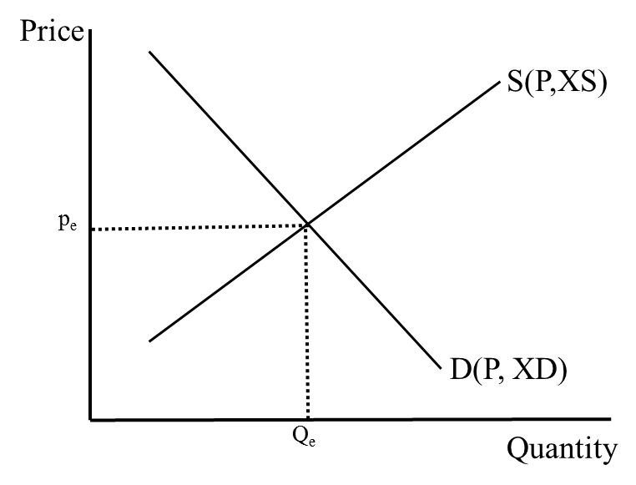
Structural vs. Reduced-form Models
Structural Model of Supply and Demand:
Reduced-form Model
(no endogenous variables):

Slide 18
The Skeptic
“In ideal circumstances, randomized evaluations of projects are useful for obtaining a convincing estimate of the average effect of a program or project.
The price for this success is a focus that is too narrow to tell us “what works” in development, to design policy, or to advance scientific knowledge about development processes.”
-Angus Deaton

Slide 19
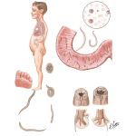

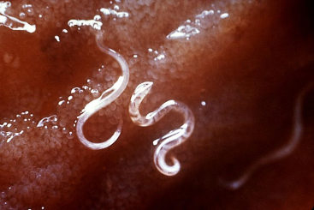



What better way to start the day than with…
Helminths

Slide 20
The Problem
Hookworm and roundworm each infect approximately 1.3 billion people around the world
while whipworm affects 900 million and 200 million are infected with schistosomiasi

Slide 21
The Other Problem
Intense worm infections reduce kids’ educational achievement

Slide 22

An Experiment in Kenya
Randomly treat all kids in some schools
..but not other schools (the control group)
Then see if school attendance goes up for the kids in the treated schools

Slide 23

Clean, Straightforward. but…
The treated schools “treated” the control schools
…making it harder to show the treatment worked
Edward Miguel and Michael Kremer. “Worms: Identifying Impacts on Education and Health in the Presence of Treatment Externalities.” Econometrica 72(1, January):159-217, 2004

Slide 24
Treatment Externalities and Control-group Contamination
What’s an externality?
How treatments spread to the non-treated
Control-group contamination
Non-treated
Treated
…But what if:

Slide 25
Externalities in RCTs
Control-group contamination:
Two possibilities:
  Treatment has positive externality:
    It’s harder to show the treatment has a positive impact, since both Y_{1,i} and Y_{0,i} ↑
  Treatment has negative externality:
    You conclude the treatment had a positive impact when maybe it didn’t
    Is treatment group better off, or control worse off?

Slide 26
Linkages and Worms
Linkages transmit impacts from the treatment group to others in the local population
…creating higher-level impacts
Here’s a picture to illustrate our Africa work

Slide 27
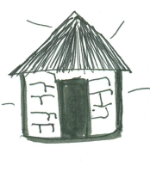
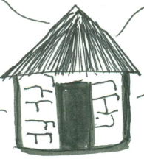
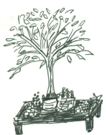
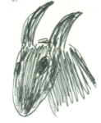
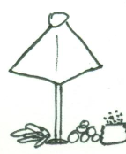
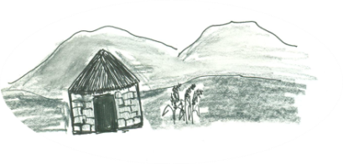
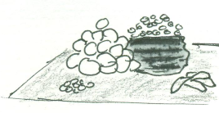

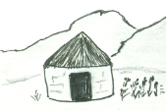


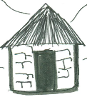



Treatment
Transfer
Rest of World
Control?
Rest of Zimbabwe
Notes:
2 things from this picture – ge effects (feedback) and spillovers, generally

Slide 28
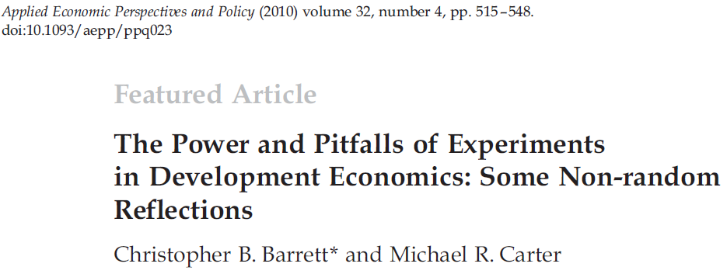
The Ethics of Randomized Control Trials

Slide 29
1. Do No Harm?
Gugerty and Kremer (2008) tests whether grants of money to women’s organizations in Kenya distorts them and leads to the exclusion of poorer women and their loss of benefits (Answer: yes. Experiment arguably hurt poor women to show this.)
Randomly giving loans to people who don’t qualify

Slide 30
2. Informed Consent
Individuals are often unaware that they are (or are not) part of an experiment
Biomedical researchers have given this issue much thought, but development economists less so

Slide 31
3. Unblindedness
Those who know themselves to be in a control group may suffer emotional distress
  …which can have adverse biophysical consequences that exaggerate the differences between control and treatment groups
But does blindedness make sense in economic experiments?

Slide 32
4. The Ethics of Not Targeting
Randomized interventions treat individuals who don’t need the treatment
  …wasting scarce resources
  …and encouraging project implementers to violate the randomized research design
This raises ethical questions and makes it hard to keep the experiment “clean”
  It’s easy to lose control of the experiment

Slide 33
“Which of the eligible households do you want to kill?”
-Minister of Gender, Children and Community Development

Slide 34
So It’s Effective. Is It Worth Doing?
Just because a treatment is beneficial doesn’t mean it’s the best way to do something
…or that it will have the same benefits once you “ramp it up,” say, to all villages
Need a cost-benefit analysis
Increasingly, people want to know whether the total impact justifies the project’s cost

